Slide 1
Advanced Virtual Mouse
Technologies used :
Python programming language
PC / Laptop
Webcam
Pycharm (IDE)
Packages
Open CV
MediaPipe
AutoPy
NumPy

Slide 2
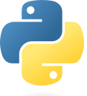
Python programming language
Python is a high-level, general-purpose programming language.
Its design philosophy emphasizes code readability with the use of significant indentation.
Python is dynamically-typed and garbage-collected.
It supports multiple programming paradigms, including structured, object-oriented and functional programming.
Version used : 3.7.4

Slide 3
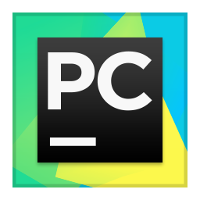
Pycharm (IDE)
PyCharm is a dedicated Python Integrated Development Environment (IDE) providing a wide range of essential tools for Python developers, tightly integrated to create a convenient environment for productive Python, web, and data science development.
Version used : 2022.2.1

Slide 4
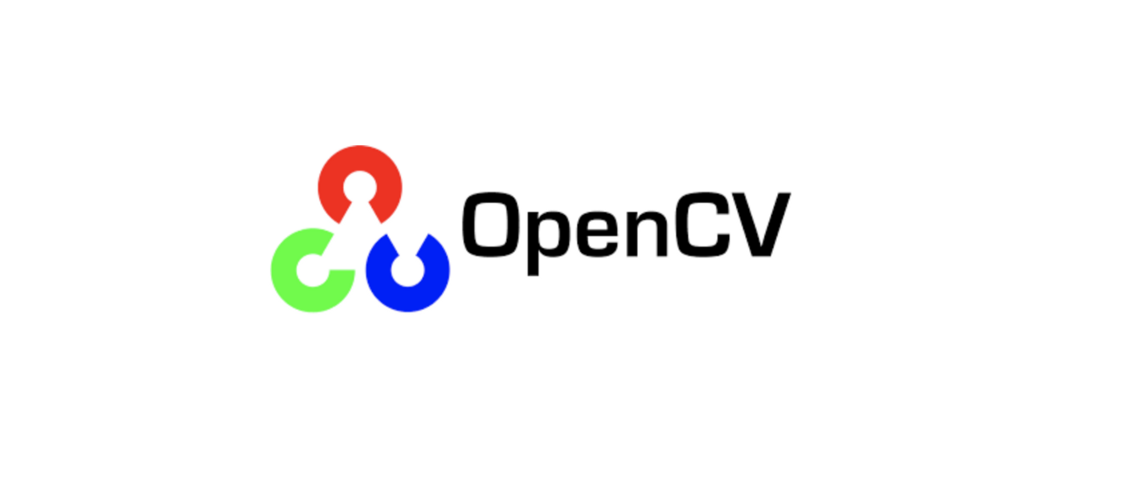
Packages used :
Open CV
OpenCV is a library of programming functions mainly aimed at real-time computer vision. Originally developed by Intel, it was later supported by Willow Garage then Itseez. The library is cross-platform and free for use under the open-source Apache 2 License.

Slide 5

MediaPipe
The ability to perceive the shape and motion of hands can be a vital component in improving the user experience across a variety of technological domains and platforms. For example, it can form the basis for sign language understanding and hand gesture control, and can also enable the overlay of digital content and information on top of the physical world in augmented reality. While coming naturally to people, robust real-time hand perception is a decidedly challenging computer vision task, as hands often occlude themselves or each other (e.g. finger/palm occlusions and hand shakes) and lack high contrast patterns.

Slide 6
MediaPipe Hands is a high-fidelity hand and finger tracking solution. It employs machine learning (ML) to infer 21 3D landmarks of a hand from just a single frame. Whereas current state-of-the-art approaches rely primarily on powerful desktop environments for inference, our method achieves real-time performance on a mobile phone, and even scales to multiple hands. We hope that providing this hand perception functionality to the wider research and development community will result in an emergence of creative use cases, stimulating new applications and new research avenues.

Slide 7
AutoPy
AutoPy is a simple, cross-platform GUI automation library for Python. It includes functions for controlling the keyboard and mouse, finding colors and bitmaps on-screen, and displaying alerts.
Currently supported on macOS, Windows, and X11 with the XTest extension.

Slide 8
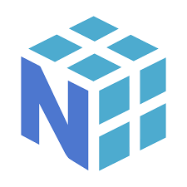
NumPy
NumPy is a library for the Python programming language, adding support for large, multi-dimensional arrays and matrices, along with a large collection of high-level mathematical functions to operate on these arrays.

Slide 9
Computer Vision
Computer vision is a field of artificial intelligence (AI) that enables computers and systems to derive meaningful information from digital images, videos and other visual inputs — and take actions or make recommendations based on that information.
If AI enables computers to think, computer vision enables them to see, observe and understand.
Computer vision works much the same as human vision, except humans have a head start.
Human sight has the advantage of lifetimes of context to train how to tell objects apart, how far away they are, whether they are moving and whether there is something wrong in an image.
Computer vision trains machines to perform these functions, but it has to do it in much less time with cameras, data and algorithms rather than retinas, optic nerves and a visual cortex.
Because a system trained to inspect products or watch a production asset can analyze thousands of products or processes a minute, noticing imperceptible defects or issues, it can quickly surpass human capabilities.

Slide 10
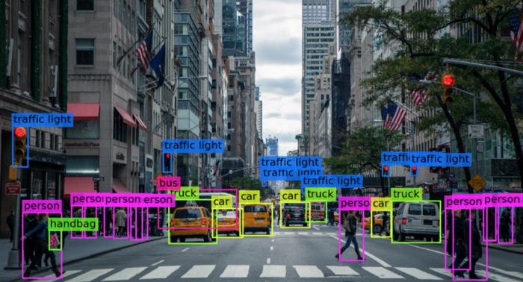

Slide 11
Hand tracking
Hand tracking is the process in which a computer uses computer vision to detect a hand from an input image and keeps focus on the hand’s movement and orientation.
Hand tracking allows us to develop numerous programs that use hand movement and orientation as their input.
We tend to write the same code in different projects to perform hand tracking as part of our program.
Creating a hand tracking module solves this problem since we write the code once.
We then convert this piece of code into a module.
We can import this module into any python project that we are working on and it will perform hand tracking.

Slide 12
